Slide 1
ASP.NET

Slide 2
What is .NET ?
Microsoft.NET is a Framework
Microsoft .NET is a Framework which provides a common platform to Execute or, Run the applications developed in various programming languages.
Microsoft announced the .NET initiative in July 2000.
The main intention was to bridge the gap in interoperability between services of various programming languages.

Slide 3
.NET Framework Objectives
The .NET Framework is designed to fulfill the following objectives:
Provide object-oriented programming environment
Provide environment for developing various types of applications, such as Windows-based applications and Web-based applications
To ensure that code based on the .NET Framework can integrate with any other code
Notes:
Faculty Notes:

Slide 4
.NET Framework
VB
C++
C#
JScript
…
Visual Studio 2008
Common Language Specification
ASP.NET
Windows Forms
ADO.NET
Base Class Library
(CLR) Common Language Runtime
Operating System
Notes:
Faculty Notes:
Figure above illustrates the Microsoft .NET Framework. All .NET languages are built on a Common Language Specification. While designed specifically to support the .NET versions of Visual Basic, C++, C# and JScript, .NET also supports other languages that can be modified to this specification. These include Perl, Python, COBOL, Eiffel, Pascal, Fortran, SmallTalk, Java, RPG, Ada, APL, J# and others.
The .NET Framework is designed to unify programming models to enable cross-language integration.
The Microsoft Active Server Page (ASP) technology has been enhanced as ASP.NET and is designed to allow the easy development of Web services and Web forms see figure above. The development of Windows forms has also been improved with .NET, and ADO.NET provides full support for data and XML. Visual Studio 2005 supports and integrates all of these development environments, automating many development tasks that previously required manual integration.
Each of the languages in the figure is supported by Visual Studio 2005, which is an enhanced IDE. The other languages discussed earlier can also be added to Visual Studio 2005. The strategy behind Visual Studio 2005 is to enable applications to be developed within Windows for later execution in a .NET environment on any platform.

Slide 5
The .NET Framework consists of:
The Common Language Specification (CLS)
It contains guidelines, that language should follow so that they can communicate with other .NET languages. It is also responsible for Type matching.
The Framework Base Class Libraries (BCL) A consistent, object-oriented library of prepackaged functionality and Applications.
The Common Language Runtime (CLR) A language-neutral development & execution environment that provides common runtime for application execution .
Notes:
Faculty Notes:
Just read out the slide the sub point are explained in next slide

Slide 6
Common Language Specification
CLS performs the following functions:
Establishes a framework that helps enable cross-language integration, type safety, and high performance code execution
Provides an object-oriented model that supports the complete implementation of many programming languages
Defines rules that languages must follow, which helps ensure that objects written in different languages can interact with each other

Slide 7
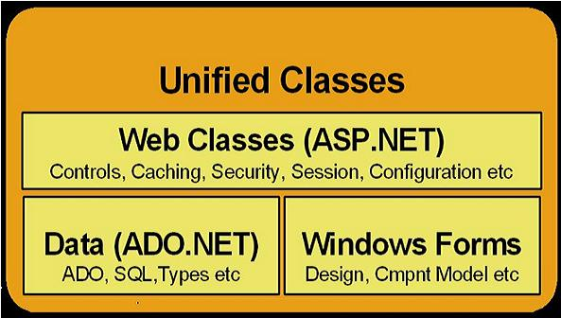
.NET Framework Base Class Library
The Class Library is a comprehensive, object-oriented collection of reusable types
These class library can be used to develop applications that include:
Traditional command-line applications
Graphical user interface (GUI) applications
Applications based on the latest innovations provided by ASP.NET
Web Forms
XML Web services

Slide 8
Common Language Runtime (CLR)
CLR ensures:
A common runtime environment for all .NET languages
Uses Common Type System (strict-type & code-verification)
Memory allocation and garbage collection
Intermediate Language (IL) to native code compiler. Which Compiles MSIL code into native executable code
Security and interoperability of the code with other languages
Over 36 languages supported today
C#, VB, Jscript, Visual C++ from Microsoft
Perl, Python, Smalltalk, Cobol, Haskell, Mercury, Eiffel, Oberon, Oz, Pascal, APL, CAML, Scheme, etc.

Slide 9
Execution in CLR
Source code
VB
C#
C++
Compiler
Compiler
Compiler
Managed
code
Assembly
IL Code
Assembly
IL Code
Assembly
IL Code
Common Language Runtime
JIT Compiler
Native Code
Operating System Services
Notes:
Faculty Notes:
We already know that an assembly does NOT contain native binary code, but instead MSIL code. Obviously before the MSIL code can be executed it must be converted into native binary instructions. Converted? Does this mean interpreted? NO! The MSIL code is compiled and not thrown away. This means that the next time the code is requested it is already in the form of machine instructions and thus this mechanism in the log run is far more efficient than an interpreter for example.
The compilation is carried out by a JIT (Just In Time) compiler. Does the compiler compile all of the code in one go? The answer to this question is NO. If this approach was taken there would be a long delay during the applications initialization, and realistically not all the code within the module will be required in one go. Instead, when the code is loaded a ‘stub’ is connected to each method. When a method is called via the stub the compiler generates the binary native code. This mechanism goes a long way to describing why the compiler is called a ‘JIT’ compiler.
Compiled code is only saved in the same process (run) of an application. And even then it's not guaranteed. We do what's called "code-pitching" which means we through away cold (or little used) JITed code if memory pressure requires it. We do persisted JITed code in the install time scenario.
The benefit to this system is obviously portability. A couple of things to think about -
Let’s imagine you’ve built a managed component for the Intel Pentium III platform. It works fine. Later in the year Intel released a super new chip. When Microsoft released a new version of the JIT, it’s possible that this brand spanking new version of the JIT will have learned a few new tricks e.g. to make use of the new improved instruction set of the new Intel chip or new CPU registers!
And finally, Microsoft plans to offer a tool called PREJIT. This tool will compile your assemblies into native code and save the resultant binary executable code to disk. When the assemblies are next loaded the binary code is already available thus improving startup time and execution speeds.

Slide 10

Introduction to ASP.NET

Slide 11
Introduction to ASP.NET
ASP.NET is part of the Microsoft .NET framework
ASP.NET is an effective and flexible technology for creating interactive and dynamic web pages.
It is a convergence of two major Microsoft technologies:
Active Server Pages (ASP)
Active Server Pages is Microsoft’s server side scripting technology for building dynamic web pages.
.NET Framework
The .NET Framework is a suite of technologies designed by Microsoft where program development takes place.
Notes:
Faculty Notes
ASP.NET applications can be written in any .NET compatible language like Visual Basic .NET, C#, and JScript .NET.

Slide 12
Introduction to ASP.NET
It is built on .NET Common Language Runtime
ASP.NET :
Provides better user authentication
Has better language support.
Has a large set of new controls (web controls)
Uses compiled code, which increases the performance of the applications
It is programmable using any of the .NET languages (VB.NET, C#, VJ# etc).
The ASP.NET pages are saved with the .aspx extension.

Slide 13
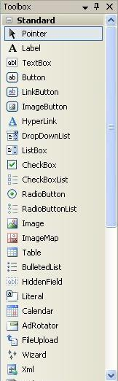
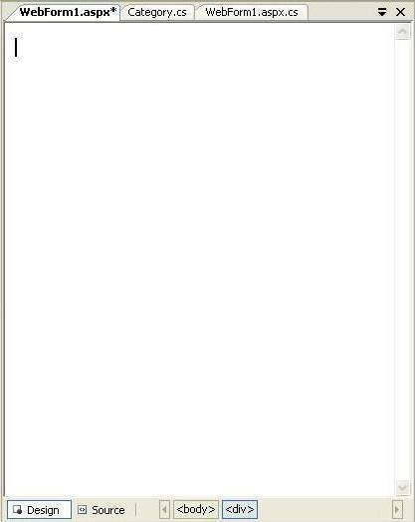
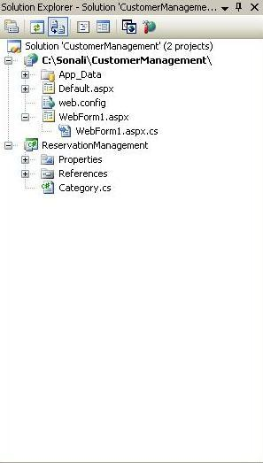
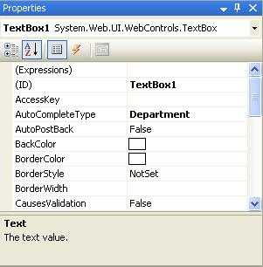
Visual Studio 2008 IDE
Title Bar
Menu Bar
Tool Box
Document window
Solution Explorer
Properties Window
Status Bar
Notes:
Faculty Notes:
Run this slide

Slide 14
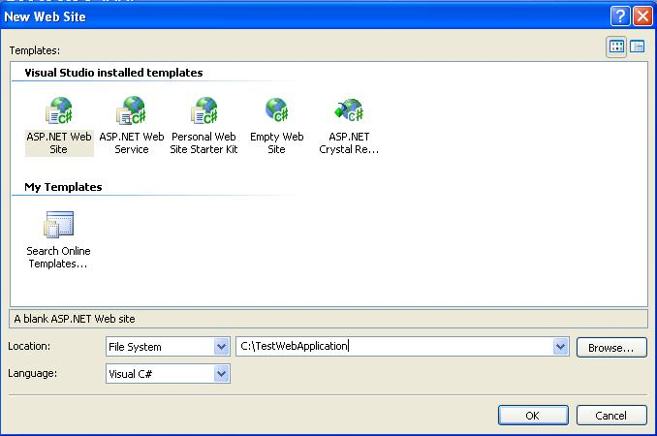
Creating a New Web Application
To start a new Web Application in VS 2008, Click the Create Web Site button on the Start page or Select File > New > Web Site
The New Web Site allows you to choose:
Templates
Language for creating an
application
Location where the application
will be created
Notes:
Faculty Notes:
This slide demonstrates how to create a new Web Application in VS 2008.
You can also create other projects such as a Windows Application, Class Library, Console Application etc;
by selecting File > New > Project and then selecting the required project.

Slide 15
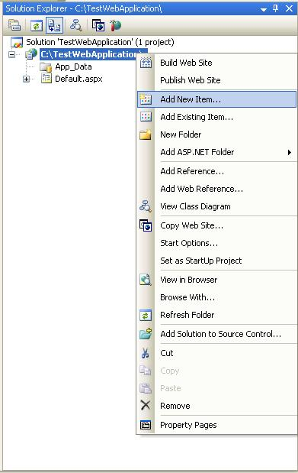
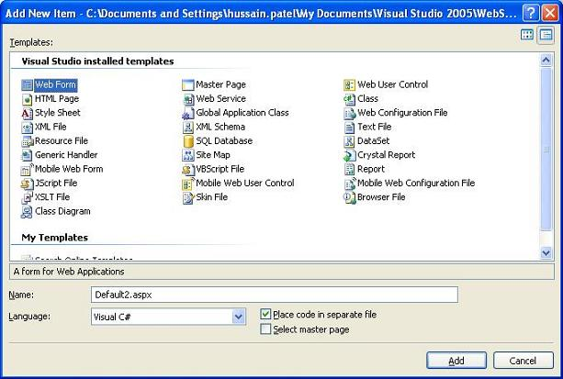
Creating a New Application (Continued)
After you create a new Web Application, Default.aspx page is added to this Website. To Rename this page, Select the page from the Website node in the Solution Explorer > Right Click > Rename.
Files can be added to the Project, using Solution Explorer:
Right click on the project node, in the Solution Explorer, and select the option Add New Item.
The Add New Item window will popup.
Select the type of file (item) to be added and click on Add.
Notes:
Faculty Notes:
Read the content in the slide (Self-explanatory)

Slide 16
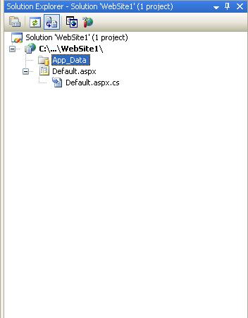
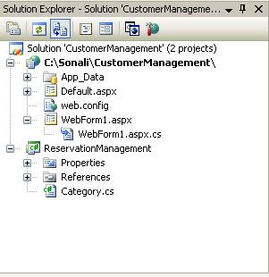
Solution Explorer
Presents a tree view structure of files present in the project.
By default a New Website will contain:
An App_Data folder
A Default.aspx page (including Default.aspx.cs)
To view Solution Explorer:
Select View > Solution Explorer
OR
Press buttons Ctrl+W,S
Notes:
Faculty Notes
Read the content in the slide (Self-explanatory)
Note: You can add multiple projects in a single Solution Explorer.

Slide 17

Solution Explorer (Continued)
The Toolbar at the top of Solution Explorer enables various tasks.
Code
Refresh
Copy Website
Properties
View Designer
Nest Related Files
ASP.NET Configuration
Notes:
Faculty Notes
Explain the following tasks:
Properties – Displays the properties window for the selected file
Refresh - Refreshes the Solution Explorer
Nest Related Files - Undoes the nesting found in ASP.NET files developed by using code-behind files
Code - Displays the code behind file/s
View Designer - Displays the document window
Copy Website – Enable you to copy your application from one point to another (on the same server or on a different server) by opening a new dialog in the document window
ASP.NET Configuration – Displays the ASP.NET configuration page within the document window

Slide 18
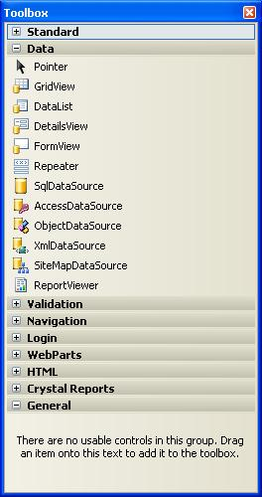
Toolbox
To add controls in the Design Window use Toolbox.
There are various tool tabs available in the Toolbox.
The controls in the IDE are presented in a hierarchical manner (e.g., Standard Tab, Data Tab, Validation, Navigation, WebParts etc.).
Depending on the type of project (application) the toolbox tabs will vary.
To view the tool box:
Select menu View > Toolbox
OR
Press buttons Ctrl+Alt+X or Ctrl+W, X
You can also view the controls as icons by right-clicking on the toolbox you want to change and deselecting the List View.
Notes:
Faculty Notes
Read the content in the slide (Self-explanatory)
Use ToolBox to add controls in the Design Window.
Just drag and drop the required controls in the design window and the control gets added to your application.

Slide 19
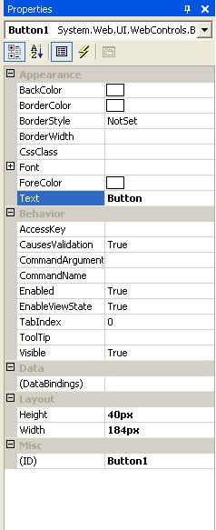
Properties Window
To view or change the properties and events of a selected control during design use the Properties Window
To configure a control:
Click once to select it
Press F4 or Select menu View > Properties window
Modify the appropriate properties in the window
There are various options provided for viewing the properties of the selected control, such as:
Categorized view
Alphabetical view
Properties view (default)
Events View
Property pages
Notes:
Faculty Notes:
Properties shown in grey are read-only
The default view for the Selected control properties view is displayed. Use:
Categorized View (to view the properties by category)
Alphabetical View (to view the properties in alphabetical order)
Events View (to view the events associated with the control)
Property Pages (to view the property page of an option)

Slide 20
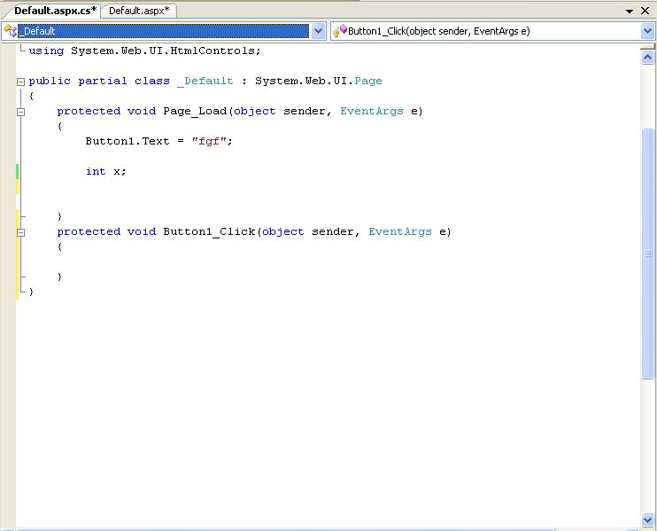
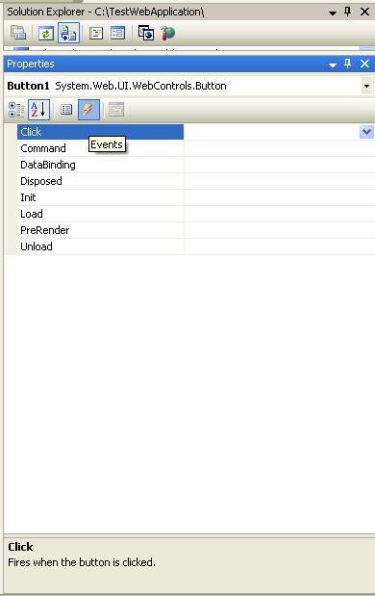
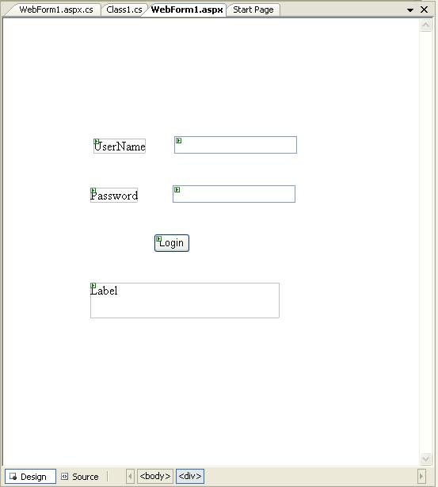
Adding an Event
Events can be added to the code in one of three ways:
Double clicking a control in design view
Typing the code manually
Selecting the Events Icon and double clicking the required event from the Properties Window
Event Handler For Button
Notes:
Faculty Notes:
Type it in manually
You must specify the appropriate parameters and the handles clause
Double-click on a control in the design view
For example, double-click on the page, it will create a Page.Load event handler. Double-click on a button or input control, it will create the required click or change event handler.
Choose the event from the drop-down list:
Once you double-click the control, the events get added to the drop-down list on the top of the code view.
You can choose the required event from this list.

Slide 21
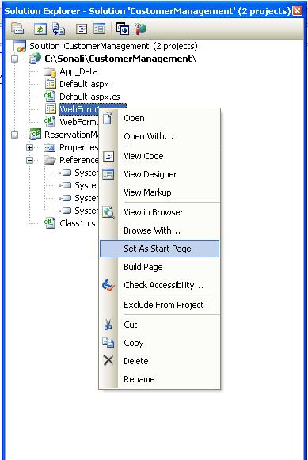
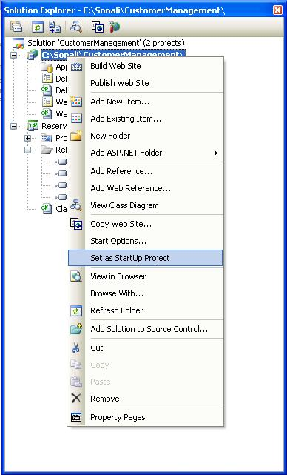
Project Settings
Project Settings can be adjusted using various options in the Project Properties menu or by using the Solution Explorer window.
These settings change based on the type of application developed.
Setting Startup Page:
Right Click on the form you want set as the startup page in the Solution Explorer.
Select option Set As Start Page.
Startup Project (In case of multiple projects):
Right Click on Project to set as startup project in the Solution Explorer.
Select Option Set As StartUp Project.

Slide 22
Web controls
These are some of the reasons you should switch to web control
They provide a rich user interface
They provide a consistent object model
They tailor their output automatically

Slide 23
ASP.NET actually provides two sets of server-side controls that you can incorporate into your web
forms. These two types of controls play subtly different roles
HTML server controls: These are server-based equivalents for standard HTML elements. These controls are ideal if you’re a seasoned web programmer who prefers to work with familiar HTML tags (at least at first). They are also useful when migrating ordinary HTML pages or classic ASP pages to ASP.NET, because they require the fewest changes.

Slide 24
Web controls: These are similar to the HTML server controls, but they provide a richer object model with a variety of properties for style and formatting details. They also provide more events and more closely resemble the controls used for Windows development. Web controls also feature some user interface elements that have no direct HTML equivalent, such as the GridView, Calendar, and validation controls.

Slide 25
ASP.NETArchitecture
ASP application
ProcessXML.aspx
ProcessXML.aspx.cs
Web.config
Page Class
MapPath()
Application
ContentType
Context
IsPostBack
Request
Response
Server
Session
Trace
User
…
ProcessXML_aspx
Page_Load(Object, System.EventArgs)
Button1_Click(Object, System.EventArgs)
InitializeComponent()
…

Slide 26
Page Events
public event EventHandler Init; Page_Init(object,EventArgs)
public event EventHandler Load; Page_Load(object,EventArgs)
public event EventHandler PreRender; Page_PreRender(object,EventArgs)
public event EventHandler Unload; Page_Unload(object,Eventargs)
protected virtual void OnInit(EventArgs e);
protected virtual void OnLoad(EventArgs e);
protected virtual void OnPreRender(EventArgs e);
protected virtual void OnUnload(EventArgs e);

Slide 27
ASP.Net Directives
@Page
Defines Language and Code-Behind file
@Import Namespaces
Equivalent to using directives
@Register
Registers user controls with page. Page will call render on each of its registered controls.
@Implements
Declares an interface this page implements
@Reference
Specifies a page or user control that will be compiled and linked at run-time
@Assembly
Links an assembly to the current page during compilation
Plus more – see help documentation

Slide 28
Page Attribures
CodeFile
Specifies a path to a code-behind file for the page. Used with Inherits attribute.
Inherits
Defines a code-behind class for the page to inherit.
AutoEventWireup
If true, the default, simple event handlers are wired up automatically
Debug
If true, code behind is compiled with debug symbols

Slide 29
Controls
HTML Controls
HTML syntax
runat=server attribute
Derives from HtmlControl
Instance created at server when page is constructed
Examples:
<form runat=server>
<img runat=server>
<input type=file runat=server>
<input type=radio runat=server>
Web Controls
asp: prefix
runat=server attribute
Derives from WebControl
Instance created at server when page is constructed
Richer set of methods, properties, and events than HTML Controls
Examples:
<asp:TextBox id=tb1 runat=server>
<asp:Button Text=“Submit” runat=server>

Slide 30
Web Control Catalog
TextBox
Label
HyperLink
Image
CheckBox
RadioButton
Table – matrix addresses
Panel
Button
ListBox
DropDownList
CheckBoxList
RadioButtonList
Repeater – HTML template
DataList – HTML template
DataGrid – no longer in toolbox by default, but can be added
Calendar
Validation Controls
RequiredField
RegularExpression
Range
Compare
Custom

Slide 31
Data Related Controls
Data Controls
GridView
DataList
DetailsView
FormView
Repeater
SqlDataSource
ObjectDataSource
XmlDataSource
SiteMapDataSource
Validation Controls
RequiredFieldValidator
RangeValidator
RegularExpressionValidator
CompareValidator
CustomValidator

Slide 32
More Controls
Navigation Controls
SiteMapPath
Menu
TreeView
Login Controls
Login
LoginView
PasswordRecovery
LoginStatus
LoginName
ChangePassword
Webparts
WebPartManager
ProxyWebPartManager
WebPartZone
CatalogZone
DeclarativeCatalogPart
PageCatalogPart
ImportCatalogPart
EditorZone
AppearanceEditorPart
BehaviorEditorPart
LayoutEditorPart
PropertyGrideEditorPart
ConnectionsZone

Slide 33
Data Binding
Data Binding Controls
HtmlSelect
CheckBoxList
DataGrid
DataList
Repeater
DropDownList
ListBox
RadioButtonList
Data Sources
Array
ArrayList
HashTable
Queue
SortedList
Stack
StringCollection
DataView
DataTable
DataSet
IDataReader
Classes that implement IEnumerable

Slide 34
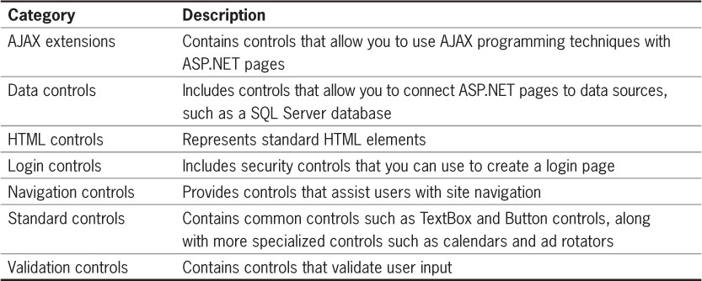
What Are the Different Types of Controls? (cont’d.)
Table 4-4 Server control categories

Slide 35
STATE MANAGEMENT
The most significant difference between programming for the Web and programming for the desktop is state management
how you store information over the lifetime of your application.
This information can be as simple as a user’s name or as complex as a stuffed-full shopping cart for an e-commerce store.

Slide 36
In a traditional desktop application, there’s little need to think about state management. Memory is plentiful and always available, and you need to worry about only a single user.
In a web application, it’s a different story. Thousands of users can simultaneously run the same application on the same computer (the web server), each one communicating over a stateless HTTP connection.
These conditions make it impossible to design a web application in the same way as a desktop application

Slide 37
Understanding these state limitations is the key to creating efficient web applications. In this chapter, you’ll see how you can use.
ASP.NET’s state management features to store information carefully and consistently.
You’ll explore different storage options, including view state, session state, and custom cookies.
You’ll also consider how to transfer information from page to page by using cross-page posting and the query string.

Slide 38
In a traditional desktop application, users interact with a continuously running application. A portion of memory on the desktop computer is allocated to store the current set of working information.
In a web application, the story is quite a bit different. A professional ASP.NET site might look like a continuously running application, but that’s really just a clever illusion.
In a typical web request, the client connects to the web server and requests a page. When the page is delivered, the connection is severed, and the web server discards all the page objects from memory.
By the time the user receives a page, the web page code has already stopped running, and there’s no information left in the web server’s memory.

Slide 39
View state
One of the most common ways to store information is in view state. View state uses a hidden field that ASP.NET automatically inserts in the final, rendered HTML of a web page.
It’s a perfect place to store information that’s used for multiple postbacks in a single web page.

Slide 40
web controls use view state to keep track of certain details. For example, if you change the text of a label, the Label control automatically stores its new text in view state.
That way, the text remains in place the next time the page is posted back. Web controls store most of their property values in view state

Slide 41
View state isn’t limited to web controls. Your web page code can add bits of information directly to the view state of the containing page and retrieve it later after the page is posted back.
The type of information you can store includes simple data types and your own custom objects.

Slide 42
Storing Custom Objects
You can store your own objects in view state just as easily as you store numeric and string types.
However, to store an item in view state, ASP.NET must be able to convert it into a stream of bytes so that it can be added to the hidden input field in the page. This process is called serialization.
If your objects aren’t serializable (and by default they’re not), you’ll receive an error message when you attempt to place them in view state.
To make your objects serializable, you need to add a Serializable attribute before your class declaration.

Slide 43
Transferring Information Between Pages
One of the most significant limitations with view state is that it’s tightly bound to a specific page. If the user navigates to another page, this information is lost.
This problem has several solutions, and the best approach depends on your requirements.
In this section, you’ll learn two basic techniques to transfer information between pages: cross-page posting and the query string.

Slide 44
Cross-Page Posting
A cross-page postback is a technique that extends the postback mechanism you’ve already learned about so that one page can send the user to another page, complete with all the information for that page.

Slide 45
The Query String
Another common approach is to pass information by using a query string in the URL. This approach is commonly found in search engines.
For example, if you perform a search on the Google website, you’ll be redirected to a new URL that incorporates your search parameters.
example:http://www.google.ca/search?q=organic+gardening
The query string is the portion of the URL after the question mark. In this case, it defines a single variable
named q, which contains the string organic+gardening.

Slide 46
Advantages of query string
The advantage of the query string is that it’s lightweight and doesn’t exert any kind of burden on the server.
However, it also has several limitations:
Information is limited to simple strings, which must contain URL-legal characters.
Information is clearly visible to the user and to anyone else who cares to eavesdrop on the Internet.
The enterprising user might decide to modify the query string and supply new values, which your program won’t expect and can’t protect against.
Many browsers impose a limit on the length of a URL (usually from 1 KB to 2 KB).
Therefore, you can’t place a large amount of information in the query string and still be assured of compatibility with most browsers.

Slide 47
URL ENCODING
One potential problem with the query string is that some characters aren’t allowed in a URL. In fact, the list of characters that are allowed in a URL is much shorter than the list of allowed characters in an HTML document.
To avoid potential problems, it’s a good idea to perform URL encoding on text values before you place them in the query string.
With URL encoding, special characters are replaced by escaped character sequences starting with the percent sign (%), followed by a two-digit hexadecimal representation

Slide 48
To perform URL encoding, you use the UrlEncode() and UrlDecode() methods of the HttpServerUtility class.

Slide 49
cookies
Cookies provide another way to store information for later use. Cookies are small files that are created in the web browser’s memory (if they’re temporary) or on the client’s hard drive (if they’re permanent).
One advantage of cookies is that they work transparently, without the user being aware that information needs to be stored.
They also can be easily used by any page in your application and even be retained between visits, which allows for truly long-term storage.

Slide 50
Managing session state
Session-state management is one of ASP.NET’s premiere features.
It allows you to store any type of data in memory on the server.
The information is protected, because it is never transmitted to the client, and it’s uniquely bound to a specific session.
Every client that accesses the application has a different session and a distinct collection of information.
Session state is ideal for storing information such as the items in the current user’s shopping basket when the user browses from one page to another.

Slide 51
Session Tracking
ASP.NET tracks each session by using a unique 120-bit identifier.
ASP.NET uses a proprietary algorithm to generate this value, thereby guaranteeing (statistically speaking) that the number is unique and it’s random enough that a malicious user can’t reverse-engineer or “guess” what session ID a given client will be using.
This ID is the only piece of session-related information that is transmitted between the web server and the client.

Slide 52
When the client presents the session ID, ASP.NET looks up the corresponding session, retrieves the objects you stored previously, and places them into a special collection so they can be accessed in your code. This process takes place automatically.

Slide 53
APPLICATION STATE
Application state allows you to store global objects that can be accessed by any client.
Application state is based on the System.Web.HttpApplicationState class, which is provided in all web pages through the built-in Application object.
Application state is similar to session state. It supports the same type of objects, retains information on the server, and uses the same dictionary-based syntax.
A common example of using application state is a global counter that tracks the number of times an operation has been performed by all the web application’s clients.

Slide 54
Validation controls
verifying user input and reporting errors—and automate it.
Each validation control, or validator, has its own built-in logic. Some check for missing data, others verify that numbers fall in a predefined range, and so on. In many cases, the validation controls allow you to verify user input without writing a line of code.

Slide 55
Understanding validation
A user might ignore an important field and leave it blank.
If you disallow blank values, a user might type in semi-random nonsense to circumvent your checks. This can create endless headaches on your end. For example, you might get stuck with an invalid e-mail address that causes problems for your automatic e-mailing program.
A user might make an honest mistake, such as entering a typing error, entering a nonnumeric character in a number field, or submitting the wrong type of information.
A user might even enter several pieces of information that are individually correct but when taken together are inconsistent (for example, entering a MasterCard number after choosing Visa as the payment type)

Slide 56
RequiredFieldValidator Validation succeeds as long as the input control doesn’t contain an empty string.
RangeValidator Validation succeeds if the input control contains a value within a specific numeric, alphabetic, or date range.
CompareValidator Validation succeeds if the input control contains a value that matches the value in another input control, or a fixed value that you specify.
RegularExpressionValidator Validation succeeds if the value in an input control matches a specified regular expression.
CustomValidator Validation is performed by a user-defined function.

Slide 57
Validator-Specific Properties
Validator Control : Added Members
RequiredFieldValidator: None required
RangeValidator:MaximumValue,MinimumValue, Type
CompareValidator :ControlToCompare,Operator, Type, ValueToCompare
RegularExpressionValidator :ValidationExpression
CustomValidator :ClientValidationFunction, ValidateEmptyText, ServerValidate event

Slide 58
Using Validation Controls (Page 3)
Inherits from the BaseValidator class which inherits from the Label class
Therefore custom error messages are displayed using Label controls
Validation controls that perform comparisons inherit directly from BaseCompareValidator base class

Slide 59
Using Validation Controls (Page 4)
Common properties
Display property—shows the message
Dynamic—space for the validation message is dynamically added to the page only if validation fails
Static—space for the validation message is allocated in the page layout whether there is an error, or not
None—validation message is never displayed in the browser
ErrorMessage—displayed if the value of the control is in error (extends from Text property of a Label)
ForeColor property is the color of the error message (default color is red)

Slide 60
Using Validation Controls (Page 5)
Validate method performs validation on associated input control and updates the IsValid property
Page.IsValid (Boolean) indicates if the controls on the page are valid after the Page.Validate method executes
The following checks if the entire form is valid
Page.Validate()
If Page.IsValid Then
Message.Text = "Result: Valid!"
Else
Message.Text = "Result: Not valid!"
End If

Slide 61
Using Validation Controls (Page 6)
ControlToValidate property specifies the control to validate
For the RegularExpressionValidator control, theValidationExpression property compares control to the regular expression
Regular Expression is a rule that describes the value using a language that describes one or more groups of characters

Slide 62
Using Validation Controls (Page 7)
The ValidationExpression property
Built-in regular expressions
Regular Expression Editor
Library of sample codes
Internet E-Mail Address
\w+([-+.]\w+)*@\w+([-.]\w+)*\.\w+([-.]\w+)*
Internet URL
http://([\w-]+\.)+[\w-]+(/[\w- ./?%&=]*)?
US Phone Number
\d{3}-\d{3}-\d{4}
US Zip Code
\d{5}(-\d{4})?

Slide 63
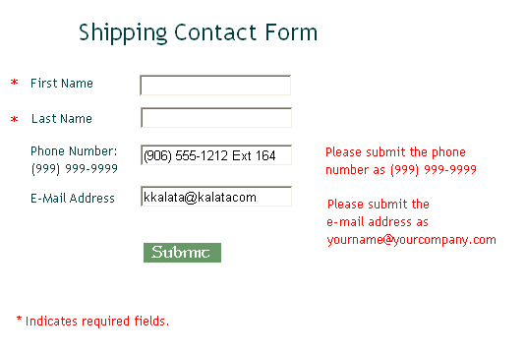
ASPValidateForm.aspx

Slide 64
Using Validation Controls (Page 8)
The ValidationSummary control
Summarizes in one location the error messages from all validators on a Web page
Properties:
DisplayMode—error messages displays as a list (List), a bulleted list (BulletList), or a single paragraph (SingleParagraph)
ShowSummary—shows the entire list
ShowMessageBox—displays errors in an alert box
HeaderText—a heading message displayed prior to the error listing

Slide 65
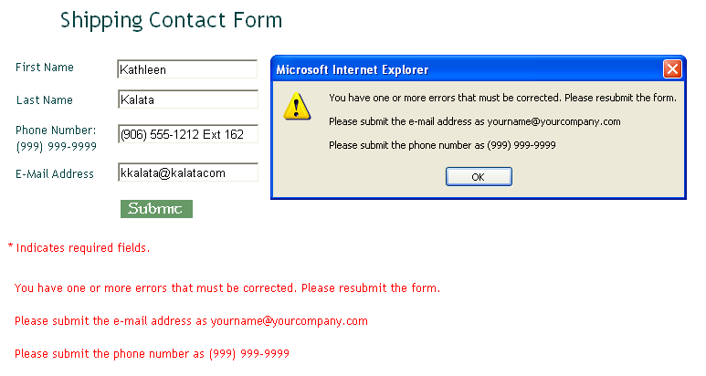
ASPValidationSummary.aspx

Slide 66
RICH CONTROLS
Rich controls are web controls that model complex user interface elements. Although no strict definition exists for what is and what isn’t a rich control, the term commonly describes a web control that has an object model that’s distinctly separate from the HTML it generates. A typical rich control can be programmed as a single object (and added to a web page with a single control tag) but renders itself using a complex sequence of HTML elements

Slide 67
You’ll start with the Calendar, which provides slick date-selection functionality. Next you’ll consider the AdRotator, which gives you an easy way to insert a randomly selected image into a web page.
Finally, you’ll learn how to create sophisticated pages with multiple views by using two advanced controls: the MultiView and the Wizard.
These controls allow you to pack a miniature application into a single page. Using them, you can handle a multistep task without redirecting the user from one page to another

Slide 68
Calendar control
The Calendar control presents a miniature calendar that you can place in any web page. Like most rich controls,the Calendar can be programmed as a single object (and defined in a single simple tag), but it renders itself with dozens of lines of HTML output.
<asp:Calendar id="MyCalendar” runat="server" />

Slide 69
AdRotator
The basic purpose of the AdRotator is to provide a graphic on a page that is chosen randomly from a group of possible images.
In other words, every time the page is requested, an image is selected at random and displayed, which is the rotation indicated by the name AdRotator. One use of the AdRotator is to show banner-style advertisements on a page, but you can use it anytime you want to vary an image randomly.

Slide 70
Pages with Multiple Views
In a typical website, you’ll surf through many separate pages. For example, if you want to add an item to your shopping cart and take it to the checkout in an e-commerce site, you’ll need to jump from one page to another.
This design has its advantages—namely, it lets you carefully separate different tasks into different code files. It also presents some challenges

Slide 71
MultiView Control
The MultiView is the simpler of the two multiple-view controls. Essentially, the MultiView gives you a way to declare multiple views and show only one at a time. It has no default user interface—you get only whatever
HTML and controls you add.

Slide 72
Wizard control
The Wizard control is a more glamorous version of the MultiView control. It also supports showing one of several views at a time, but it includes a fair bit of built-in yet customizable behavior, including navigation buttons, a sidebar with step links, styles, and templates

Slide 73
Usually, wizards represent a single task, and the user moves linearly through them, moving from the current step to the one immediately following it (or the one immediately preceding it in the case of a correction).
The ASP.NET Wizard control also supports nonlinear navigation, which means it allows you to decide to ignore a step based on the information the user supplies

Slide 74
USERS CONTROLS
user controls, which give you an efficient way to reuse a block of user-interface markup—and the code that goes with it. User controls are a key tool for building modular web applications.
They can also help you create consistent website designs and reuse your hard work.

Slide 75
A well-built web application divides its work into discrete, independent blocks. The more modular your web application is, the easier it is to maintain your code, troubleshoot problems, and reuse key bits of functionality.
User controls look pretty much the same as ASP.NET web forms. Like web forms, they are composed of a markup portion with HTML and control tags (the .ascx file) and can optionally use a code-behind file with event-handling logic.

Slide 76
User controls use the file extension .ascx instead of .aspx, and their code-behind files inherit from the System.Web.UI.UserControl class. In fact, the UserControl class and the Page class both inherit from the same base classes, which is why they share so many of the same methods and events.

Slide 77
The .ascx file for a user control begins with a <%@ Control %> directive instead of a
<%@ Page %> directive.
User controls can’t be requested directly by a web browser. Instead, they must be embedded inside other web pages

Slide 78
Working with Independent User Controls
Conceptually, two types of user controls exist: independent and integrated. Independent user controls don’t interact with the rest of the code on your form. The Footer user control is one such example.

Slide 79
Dynamic Graphics
One of the features of the .NET Framework is Windows GDI+, a set of classes designed for drawing images. You can use GDI + in a Windows or an ASP.NET application to create dynamic graphics. In a Windows application, the graphics you draw would be copied to a window for display. In ASP.NET, your code can render the graphics you want and send them directly to the client browser

Slide 80
In general, using GDI + code to draw a graphic is slower than using a ready-made image file. However,GDI + gives you much more freedom. For example, you can tailor your image to suit a particular purpose, incorporating information such as the date or current username. You can also mingle text, shapes, and other bitmaps to create a complete picture.

Slide 81
ADO.NET
.NET Data Access and Manipulation

Slide 82
Overview
What is ADO.NET?
Disconnected vs. connected data access models
ADO.NET Architecture
ADO.NET Core Objects
Steps of Data Access

Slide 83
What is ADO.NET?
A data-access technology that enables applications to connect to data stores and manipulate data contained in them in various ways
Former version was ADO (ActiveX Data Object)

Slide 84
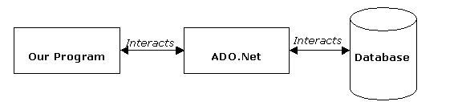
What is ADO.NET?
An object oriented framework that allows you to interact with database systems

Slide 85
Objective of ADO.NET
Support disconnected data architecture,
Tight integration with XML,
Common data representation
Ability to combine data from multiple and varied data sources
Optimized facilities for interacting with a database

Slide 86
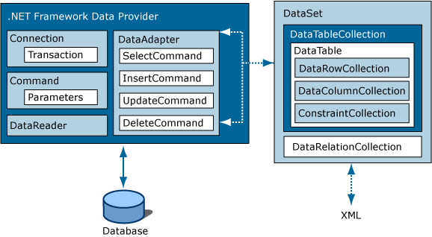
ADO.NET Architecture

Slide 87
ADO.NET Core Objects
Core namespace: System.Data
.NET Framework data providers:
Data Provider | Namespace
SQL Server | System.Data.SqlClient
OLE DB | System.Data.OleDb
ODBC | System.Data.Odbc
Oracle | System.Data.OracleClient

Slide 88
ADO.NET Core Objects
Object | Description
Connection | Establishes a connection to a specific data source. (Base class: DbConnection)
Command | Executes a command against a data source. Exposes Parameters and can execute within the scope of a Transaction from a Connection. (The base class: DbCommand)
DataReader | Reads a forward-only, read-only stream of data from a data source. (Base class: DbDataReader)
DataAdapter | Populates a DataSet and resolves updates with the data source. (Base class: DbDataAdapter)
DataTable | Has a collection of DataRows and DataColumns representing table data, used in disconnected model
DataSet | Represents a cache of data. Consists of a set of DataTables and relations among them

Slide 89
Steps of Data Access: Disconnected Environment
Defining the connection string
Defining the connection
Defining the command
Defining the data adapter
Creating a new DataSet object
SELECT -> fill the dataset object with the result of the query through the data adapter
Reading the records from the DataTables in the datasets using the DataRow and DataColumn objects
UPDATE, INSERT or DELETE -> update the database through the data adapter

Slide 90
using System;using System.Data;
using System.Data.SqlClient;
namespace SampleClass{class Program
{
static void Main(string[] args)
{string connStr =
Properties.Settings.Default.connStr;
SqlConnection conn = new SqlConnection(connStr);
string queryString = "SELECT * from titles;";
SqlDataAdapter da = new
SqlDataAdapter(queryString,conn);
DataSet ds = new DataSet();
da.fill(ds);
// Work on the data in memory using
// the DataSet (ds) object
}}}
EXAMPLE

Slide 91
Disconnected – Update, Delete, Insert
SqlDataAdapter da = new SqlDataAdapter();
DataSet ds = new DataSet();
SqlCommandBuilder cmdBuilder = new SqlCommandBuilder(da);
da.Fill(ds);
INITIAL CODE
DataRow dr = ds.Tables[0].Rows[0];
dr.Delete();
da.UpdateCommand = builder.GetUpdateCommand();
da.Update(ds);
DELETE
DataRow dr = ds.Tables[0].Rows[0];
dr["CustomerName"] = "John";
da.UpdateCommand = builder.GetUpdateCommand();
da.Update(ds);
UPDATE
DataRow dr = ds.Tables[0].NewRow();
dr["CustomerName"] = "John";
dr["CustomerSurName"] = "Smith";
ds.Tables[0].Rows.Add(dr);
da.UpdateCommand = builder.GetUpdateCommand();
da.Update(ds);
INSERT

Slide 92
Steps of Data Acces : Connected Environment
Create connection
Create command (select-insert-update-delete)
Open connection
If SELECT -> use a DataReader to fetch data
If UPDATE,DELETE, INSERT -> use command object’s methods
Close connection

Slide 93
static void Main()
{
string connectionString =
Properties.Settings.Default.connStr;
string queryString = "SELECT CategoryID, CategoryName FROM dbo.Categories;";
SqlConnection connection = new SqlConnection(connectionString);
SqlCommand command = new SqlCommand(queryString,connection);
try
{
connection.Open();
SqlDataReader reader = command.ExecuteReader();
while (reader.Read())
{
Console.WriteLine("\t{0}\t{1}“,reader[0],reader[1]);
}
reader.Close();
connection.close();
}
catch (Exception ex)
{
Console.WriteLine(ex.Message);
}
}
EXAMPLE

Slide 94
Connected – Update, Delete, Insert
Command class core methods:
ExecuteNonQuery : Executes a SQL statement against a connection object
ExecuteReader: Executes the CommandText against the Connection and returns a DbDataReader
ExecuteScalar: Executes the query and returns the first column of the first row in the result set returned by the query

Slide 95
Connected – Update, Delete, Insert
string connString = Properties.Settings.Default.connStr;
SqlConnection conn = new SqlConnection(connString);
SqlCommand cmd = new SqlCommand("delete from
Customers" + "where custID=12344", conn);
conn.Open();
cmd.ExecuteNonQuery();
conn.Close();
Can be an update or insert command

Slide 96
Choosing a DataReader or a Dataset
The type of functionality application requires should be considered
Use a dataset to:
Cache data locally in your application so that you can manipulate it
Remote data between tiers or from an XML Web service
Interact with data dynamically such as binding to a Windows Forms control or combining and relating data from multiple sources
Perform extensive processing on data without requiring an open connection to the data source, which frees the connection to be used by other clients
If readonly data is needed use DataReader to boost performance

Slide 97
ASP.NET with Ajax

Slide 98
AJAX is a developer's dream, because you can:
Read data from a web server - after the page has loaded
Update a web page without reloading the page
Send data to a web server - in the background

Slide 99
AJAX, i.e., Asynchronous JavaScript and XML, is the technique that can be used to have communication between the client and server without needing a postback.
The benefit of avoiding postback is faster response to the user, the page in the browser is not changed/refreshed/posted so the user can continue to use it while data is sent to the server and user actions like keypresses can also be communicated to the server to provide more meaningful results (example: autosuggest), i.e., enhanced overall usability of the web application.

Slide 100
A group of interrelated web development techniques used for creating interactive web applications.
Increases responsiveness and interactivity of web pages.
Definition of Postback
In the context of web development, a postback is an HTTP POST to the same page that the form is on. In other words, the contents of the form are POSTed back to the same URLas the form.
Postbacks are commonly seen in edit forms, where the user introduces information in a form and hits "save" or "submit", causing a postback. The server then refreshes the same page using the information it has just received.

Slide 101
The keystone of AJAX is the XMLHttpRequest object.
The XMLHttpRequest Object
All modern browsers support the XMLHttpRequest object.
The XMLHttpRequest object can be used to exchange data with a web server behind the scenes. This means that it is possible to update parts of a web page, without reloading the whole page.

Slide 102
ASP.NET AJAX
Is an extension to ASP.NET (From .NET 3.5 included in the Framework and partly in VS2008)
Consist of
ASP.NET 2.0 AJAX Extensions (Server side Core)
Microsoft Ajax Library (Client Side)
ASP.NET AJAX Control Toolkit with ASP.NET Controls ”combining” (server and client side, add on from community).
Supports modern browsers such as Internet Explorer, Firefox, and Safari
Mobile devices such as Windows Mobile are currently not supported

Slide 103
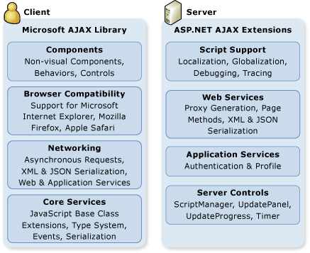
Microsoft Ajax client and server architecture

Slide 104
A Microsoft Ajax Web application consists of either a client-only solution or a client and server solution.
A client-only solution uses Microsoft Ajax Library but does not use any ASP.NET server controls.
The Microsoft Ajax Library allows Ajax applications to perform all processing on the client.
A client and server solution consists of using both the Microsoft Ajax Library and ASP.NET server controls.

Slide 105
ASP.NET AJAX Server Controls
The ASP.NET AJAX server controls consist of server and client code that integrate to produce AJAX-like behavior. The following list describes the most frequently used ASP.NET AJAX server controls. (Default in VS2008)
ScriptManager
Manages script resources for client components, partial-page rendering, localization, globalization, and custom user scripts. The ScriptManager control is required in order to use the UpdatePanel, UpdateProgress, and Timer controls.
UpdatePanel
Enables you to refresh selected parts of the page, instead of refreshing the whole page by using a synchronous postback.
UpdateProgress
Provides status information about partial-page updates in UpdatePanel controls.
Timer
Performs postbacks at defined intervals. You can use the Timer control to post the whole page, or use it together with the UpdatePanel control to perform partial-page updates at a defined interval. (The “pull updater”)

Slide 106
Microsoft AJAX Library
The ASP.NET AJAX client-script libraries consist of JavaScript (.js) files that provide features for object-oriented development. The object-oriented features included in the ASP.NET AJAX client-script libraries enable a high level of consistency and modularity in client scripting. The following layers are included in the ASP.NET AJAX script libraries:
Client components enable rich behaviors in the browser without postbacks
The browser compatibility layer provides Microsoft Ajax scripting compatibility for the most frequently used browsers (including Microsoft Internet Explorer, Mozilla Firefox, and Apple Safari). This enables you to write the same script regardless of which supported browser you are targeting

Slide 107
The networking layer handles communication between script in the browser and Web-based services and applications. It also manages asynchronous remote method calls. In many scenarios, such as partial-page updates that use the UpdatePanel control, the networking layer is used automatically and does not require that you write any code.
The networking layer also provides support for accessing server-based forms authentication, role information, and profile information in client script

Slide 108
Core Services
The Ajax client-script libraries in ASP.NET consist of JavaScript (.js) files that provide features for object-oriented development. The object-oriented features included in the Microsoft Ajax client-script libraries enable a high level of consistency and modularity in client scripting. The following core services are part of the client architecture:
Object-oriented extensions to JavaScript, such as classes, namespaces, event handling, inheritance, data types, and object serialization.
A base class library, which includes components such as string builders and extended error handling.
Support for JavaScript libraries that are either embedded in an assembly or are provided as standalone JavaScript (.js) files. Embedding JavaScript libraries in an assembly can make it easier to deploy applications and can help solve versioning issues.

Slide 109
Script Support
Script support for Ajax in ASP.NET is used to provide two important features:
The Microsoft Ajax Library, which is a type system and a set of JavaScript extensions that provide namespaces, inheritance, interfaces, enumerations, reflection, and additional features. For more information see Creating Custom Client Script by Using the Microsoft Ajax Library.
Partial-page rendering, which updates regions of the page by using an asynchronous postback.

Slide 110
Web Services
With Ajax functionality in an ASP.NET Web page, you can use client script to call both ASP.NET Web services (.asmx) and Windows Communication Foundation (WCF) services (.svc). The required script references are automatically added to the page, and they in turn automatically generate the Web service proxy classes that you use from client script to call the Web service.
You can also access ASP.NET Web services without using Microsoft Ajax server controls (for example, if you are using a different Web development environment). To do so, in the page, you can manually include references to the Microsoft Ajax Library, to script files, and to the Web service itself. At run time, ASP.NET generates the proxy classes that you can use to call the services.

Slide 111
Application Services
Application services in ASP.NET are built-in Web services that are based on ASP.NET forms authentication, roles, and user profiles. These services can be called by client script in an Ajax-enabled Web page, by a Windows client application, or by a WCF-compatible client

Slide 112
Ajax Control Toolkit
The Ajax Control Toolkit contains controls that you can use to build highly responsive and interactive Ajax-enabled Web applications. These controls do not require knowledge of JavaScript or Ajax. They are designed using concepts that are familiar to ASP.NET Web Forms application developers. Using the Ajax Control Toolkit, you can build Ajax-enabled ASP.NET Web Forms applications and ASP.NET MVC Web applications by dragging the controls from the Visual Studio Toolbox onto a page. The Ajax Control Toolkit is an open-source project that is part of the CodePlex Foundation.

